Slide 1
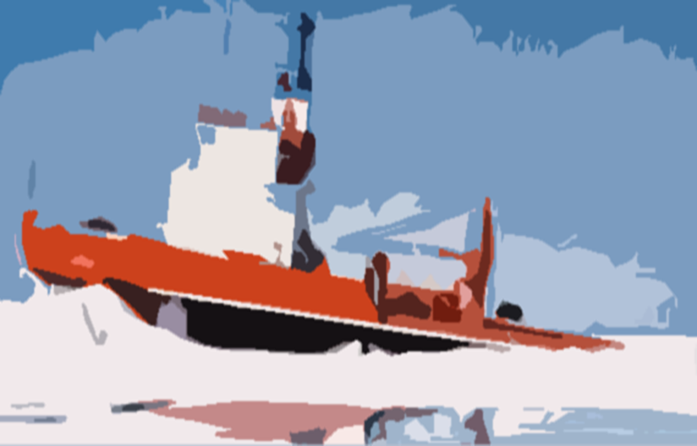
"Engineering for Canada's Northern Oceans".
A study being conducted under the auspices of the Canadian Academy of Engineering (CAE).
By
Ian Jordaan, Peter Noble, Bob Frederking and Ken Croasdale

Slide 2
General study goals
To assess Canada's offshore Arctic engineering capabilities, past achievements and future challenges; and to provide recommendations for exploiting future opportunities, and maintaining expertise.
We use the term Northern Oceans rather than Arctic – to avoid strict geographical boundaries.

Slide 3
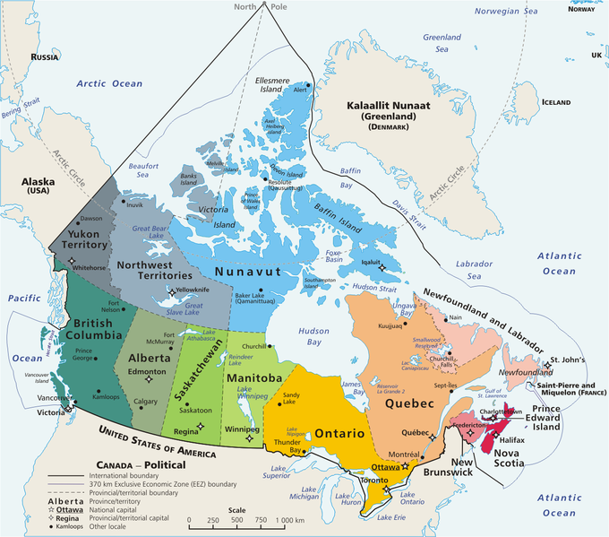

Slide 4
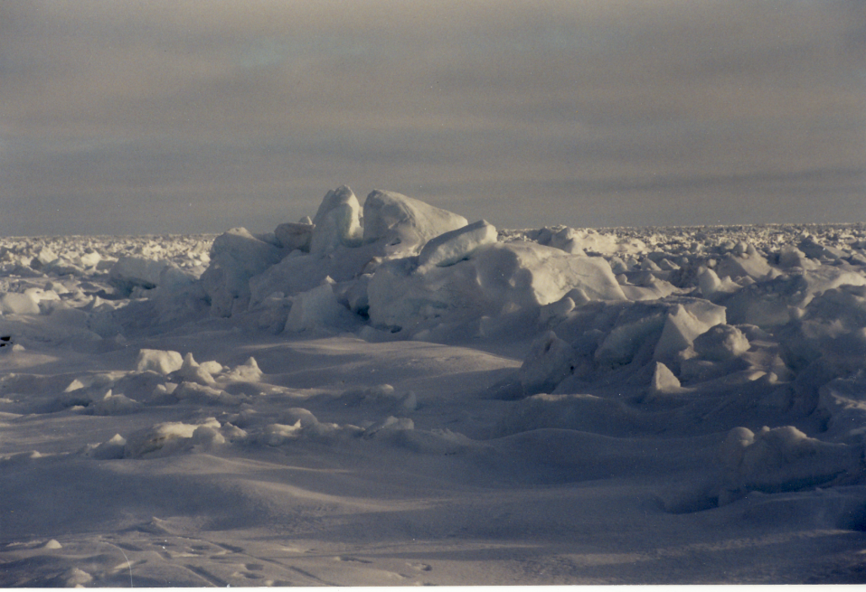
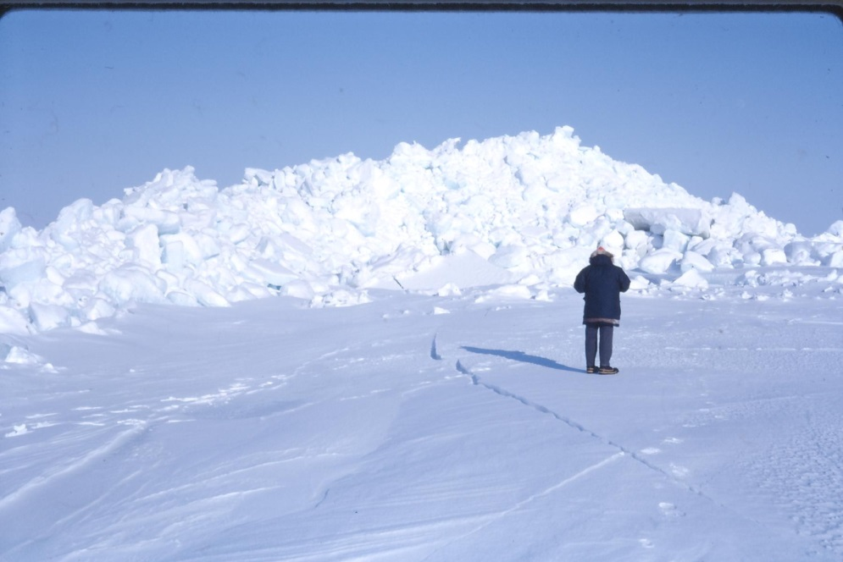
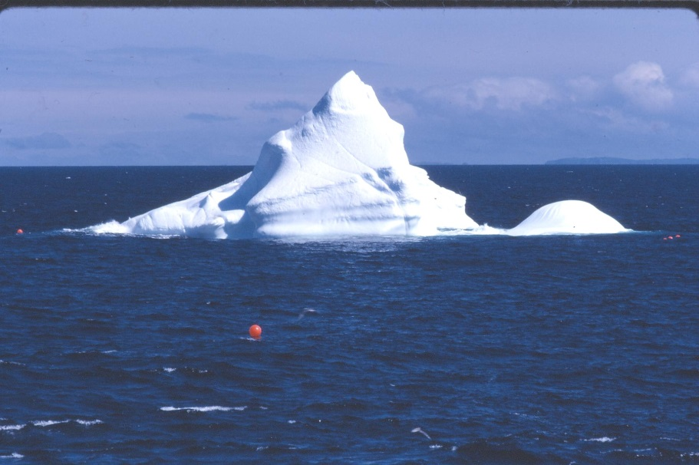
Ice morphology
When ice grows on a small lake – it will be uniform – we call this level ice. (Up to 2m thick in Arctic)
In the oceans, ice motion creates pressure ridges
These can be 35m + thick and will usually control ice loads
Other ice forms include icebergs – from glaciers (100m+)
Iceberg

Slide 5
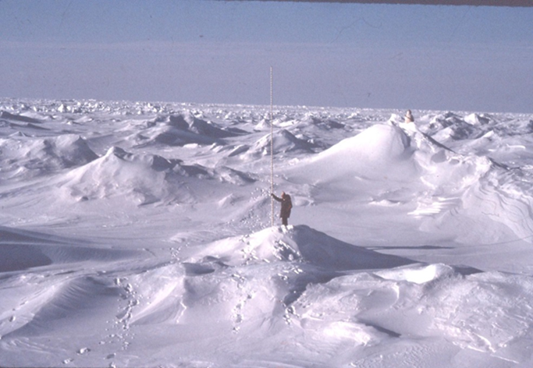
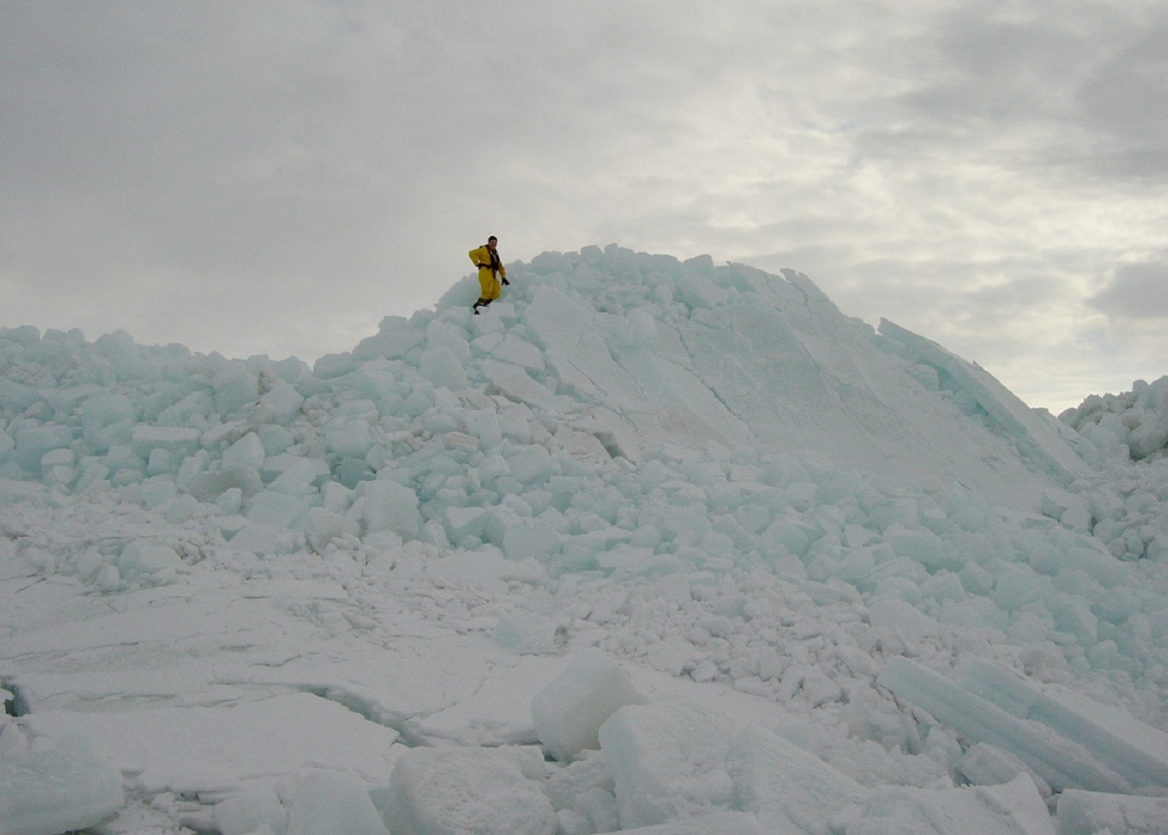
Ice which survives more than 1 year
is called multi year ice. MY ridges can
be up to 30m thick – and very strong
But even first year ice is
formidable in scale
when ridged

Slide 6
Premises to build on during the study
A large area of Canada is in the Arctic and/or influenced by Northern Oceans. (So as a country we have a stake in these regions - - and a responsibility !)
Canadians have already developed world-class expertise
in Arctic engineering (and have applied it both at home and abroad).
There are future opportunities in developing Arctic resources
and infrastructure which will create value for Canadians (as the
existing offshore oil and gas and mining developments are doing now).
There are engineering challenges associated with these future activities. (These include climate change).
Canada can build on its current expertise to address these
challenges. (But we also need to enhance it and sustain it through boom
and bust cycles).

Slide 7
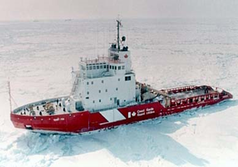
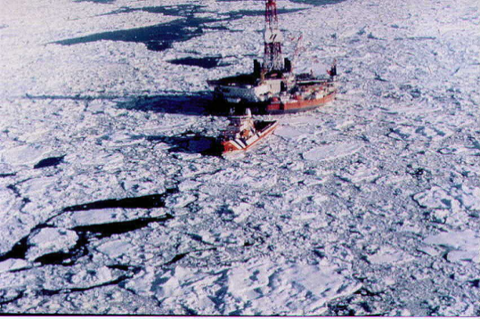
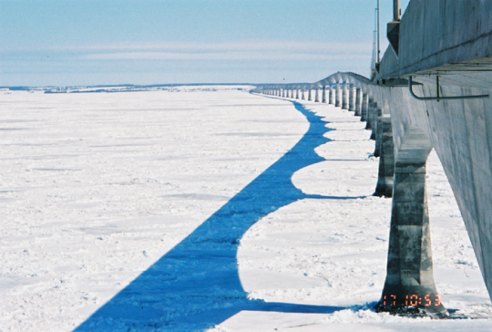
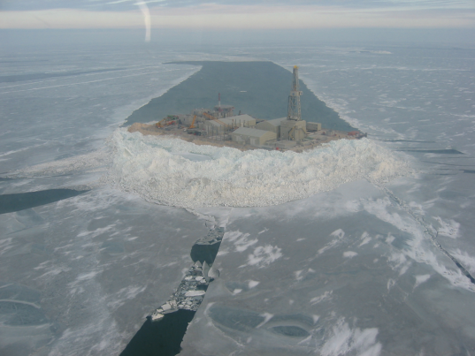
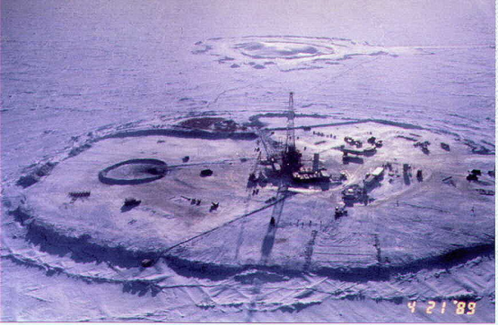
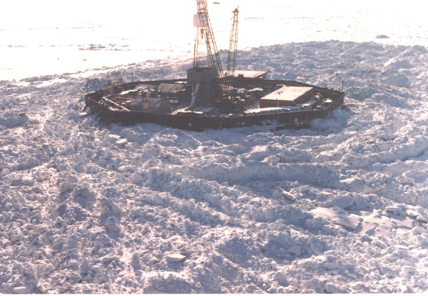
Case histories demonstrating Canadian expertise
Beaufort Sea
Arctic Islands
Grand Banks
Confederation Bridge
North Caspian Sea
Russia/Sakhalin
Polaris and Voisey’s Bay
Arctic Pilot Project
“In almost every art, experience is worth more than precepts” - Quintilian

Slide 8
Today’s Situation - industry
Many of today’s Canadian Arctic offshore engineers developed their skills in the first phase of Beaufort Sea exploration commencing in about 1970.
At that time the Canadian oil companies were prominent in pushing the technology envelope.
Today, with the exception of one, most International Companies headquarter their Arctic R&D in their home countries (e.g. Houston).
They do use Canadian expertise – but control it from their HQs

Slide 9
Todays situation – non-industry
On the other hand, Northern oceans engineering expertise has been maintained and in some cases strengthened within certain Institutes and universities. E.G. - NRC Ottawa - NRC St John’s - C-CORE and CARD (St John’s) - Memorial University (St. John’s)

Slide 10
Today’s Capabilities
A survey conducted for this study indicates
a total of about 125 Canadian Arctic “engineering” experts.
By location
By organization
BC – 16
Calgary – 42
Ottawa -- 20
St John`s – 38
Other Canadian and International – 9
Oil Companies – 20
Large Consulting Companies – 11
Small Consulting Companies – 30
Universities - 7
Institutes - 25
Government – 32

Slide 11
The changing Arctic ice
There has been significant publicity on how climate change is changing the Arctic ice.
Satellite photos show diminishing areal extent – especially in late summer.
Arctic temperatures have risen more than in the south.
Some predict Arctic ice will disappear in the summer
How does all this affect future Arctic offshore engineering ?

Slide 12
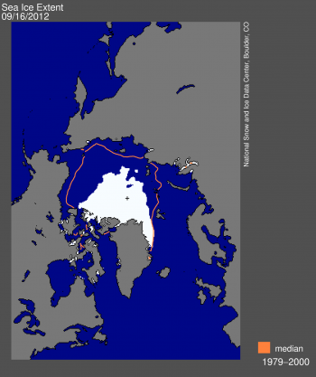
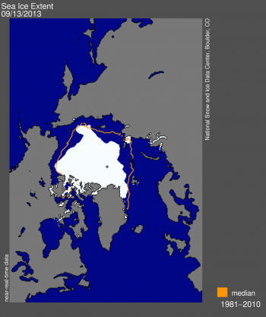
Arctic Ice Cover – September
Sept 2012 was definitely a severe minimum
September 2012
September 2013

Slide 13
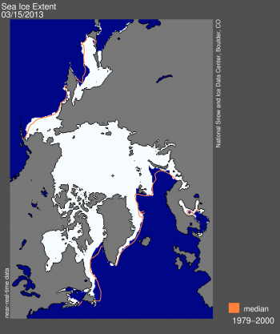
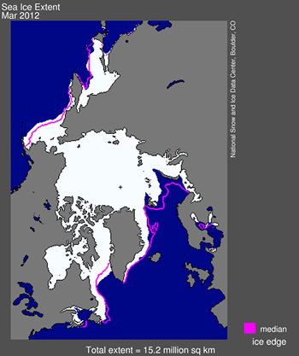
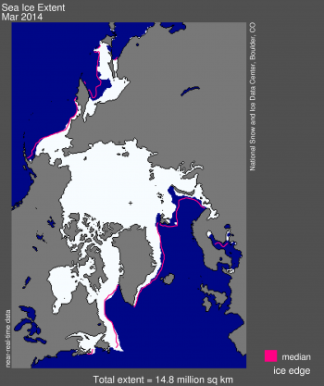
Arctic Ice Cover – March
Changes in maximum winter extent are not as dramatic
March 2012
From NSIDC
(National Snow
& Ice Data
Center, Boulder,
Colorado
March 2013
March 2014

Slide 14
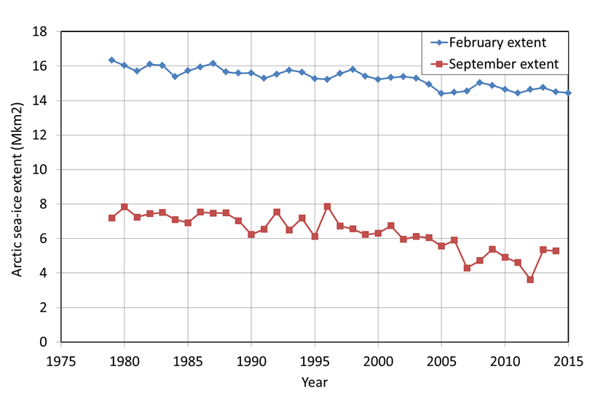
Trends

Slide 15
Driving mechanisms for less ice
Increased temperature
Export of ice through the Fram Strait.

Slide 16
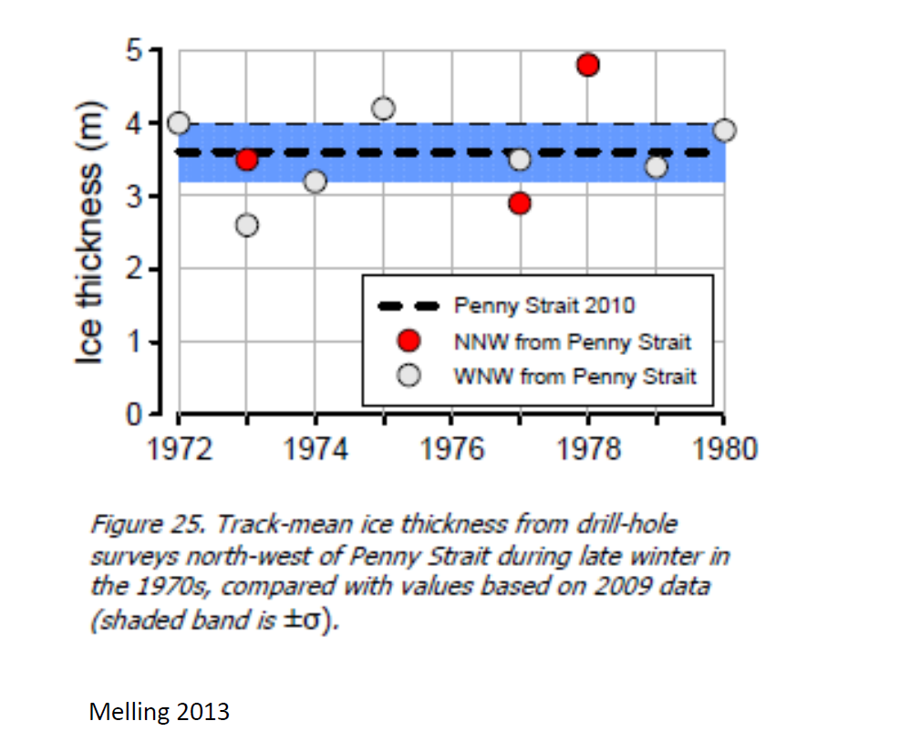
Effects of increasing temperature on ice thickness
Ice growth models show that a 2 degree global warming would only decrease ice thickness by about 5%. (1.8m to 1.7m).
The measurements by Melling (DFO) show that multi-year ice between the Arctic Islands has not thinned in the last 40 years.

Slide 17
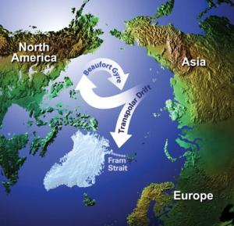
Export of ice via the transpolar drift stream (through the Fram Strait)
Experts suggest that ice export through the Fram Strait follows a multi-decadal cycle.
If the recent minimal ice extents are due to high export, then progression through the cycle to low ice export may re-establish multi year Arctic ice.
There is considerable uncertainty which engineers have to account for.

Slide 18
Effects of trends on design for ice
There is currently a reduction in both extent and average thickness of Arctic ice.
The effects on summer ice extent are the most pronounced.
For design, we still have to consider the extreme ice thicknesses at probability levels of 10⁻² and 10⁻⁴.
It is not certain that these thicknesses can be reduced for the lifetime of the structure – as discussed trends may reverse.
Even if all multi-year ice disappeared, the annual winter ice would still be formidable.

Slide 19
CURRENT NORtherN waters SHIPPING ACTIVITY With a comment on climate change Effects

Slide 20
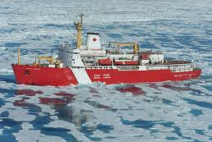
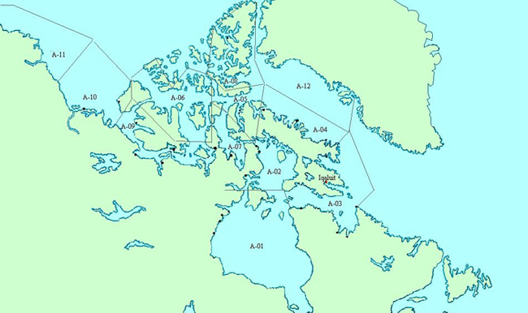
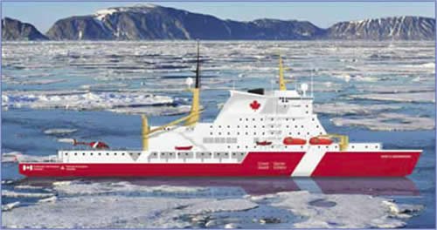
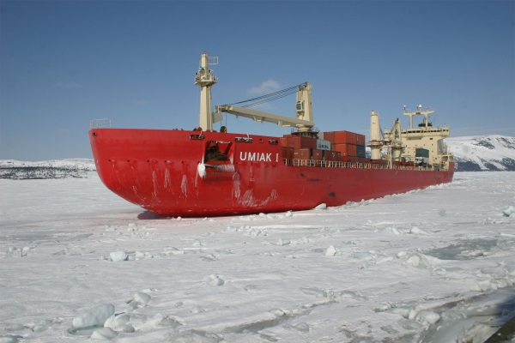
Recent Eastern Arctic Shipping
Polaris
Nanisivik
Mary River
Voisey Bay
CCGS Louis S. St. Laurent
Planned CCG Polar Icebreaker
Nunavik
MV Umiak
MV Nunavik
MV Arctic

Slide 21
Arctic Destination Shipping
Future Oil & Gas Export
Adventure Cruising
Mining Development and Mineral Export
Arctic Community Resupply
Logistics Support for Oil & Gas Exploration & Development
Oil & gas
Tourism
Resupply
Mining

Slide 22
Trans-Polar Shipping
Recent changes in summer ice cover in the Arctic - trans-polar shipping routes to connect Pacific and Atlantic ports?
Potential for significant trans-arctic shipping is probably not high, best for Russian Northern Sea Route
Low for the NW Passage due to uncertainty of ice conditions, lack of infrastructure and accurate charting,

Slide 23
SOVereignty
"Canada's new government understands that the first principle of Arctic sovereignty is: Use it or lose it,"
Prime Minister Harper 2007

Slide 25
Canada’s new Polar Icebreaker CCGS Diefenbaker
A single polar icebreaking ship will be available for arctic duties, for 9 month per year when built – 2022+??
In the meantime Canada has very limited capability to exercise any control or to fulfill obligations in Northern Waters
Artist’s Impression CCGS Diefenbaker
“The best laid plans of mice and men gang oft agley” --- Robert Burns

Slide 26
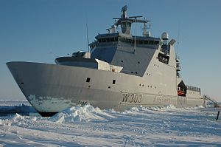
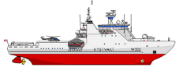
RCN Arctic Offshore Patrol Vessels
"Canada's new government understands that the first principle of Arctic sovereignty is: Use it or lose it,"
“Parent Ship” - NoCGS Svalbard
With limited ice transiting capability these ships may not be a very effective way to project Canada’s sovereignty in the Arctic
RCN - AOPS

Slide 27
CONCEPTUAL Visionary projects & programs
Other routes to Sovereignty ?
Proverbs 29:18 “Where there is no vision, the people perish”

Slide 28
International Arctic ENGINEERING EXPERIMENTAL Station (IAEES)

Slide 29
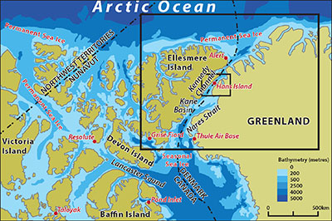
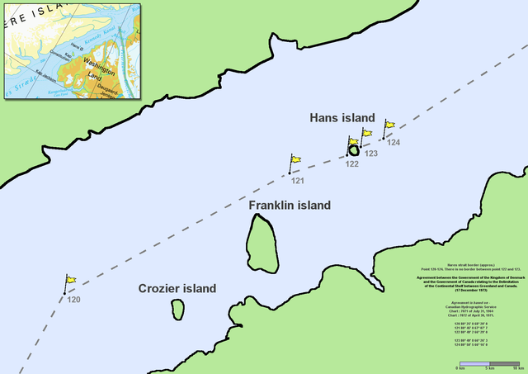
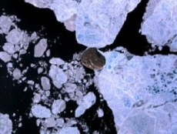
Hans Island – Kennedy Channel Canada - Denmark

Slide 30
Engineering R&D which might be carried out
Hans Island has already been used to investigate global ice impact loads on fixed structures 3 decades ago.
The IAEES could be used to experiment and study –
Ice loads on structures, spill response, power generation, water supply, Arctic aviation, drone technology for data collection in the high Arctic, and many other needed technologies.

Slide 31
International Arctic Engineering Experimental Station
There is a need for large scale experimentation to further advance Arctic marine & offshore engineering development
In the past this has been done on an ad-hoc basis and has been limited by the high logistical costs of operating in the Arctic environment.
The IAEES concept would see development of a permanent base on Hans Island, which is currently disputed territory between Canada and Denmark
The IAEES would be jointly managed by Canada and Denmark and base funding would be under-written by the Arctic Council – both member and observer nations
The concept could be similar to the Ny-Ålesund research facility in Svalbard which is managed by the Norwegian government and has ~10 countries working on arctic scientific research.
This facility could be operated under the new Canadian High Arctic Research Station, CHARS, now being developed in Cambridge Bay

Slide 32
arctic Lng - Clean green fuel for the North

Slide 33
Arctic LNG
Nunavut LNG Supply
Nunavut LNG Storage
Yukon & NWT LNG supply

Slide 34
Concept
The Arctic has an abundant supply of natural gas both in the Beaufort Sea region and in the Arctic Archipelago
Arctic communities and activities need fuel and when brought north traditional fuels are expensive, delivered in a way that puts the environment at risk and sometimes limited in supply.
Developing an Arctic LNG Public Private partnership to be able to supply LNG both for fuelling government Arctic operations and supplying local community needs would provide clean green fuel Arctic fuel which would, for example, allow year round icebreaker operations

Slide 35
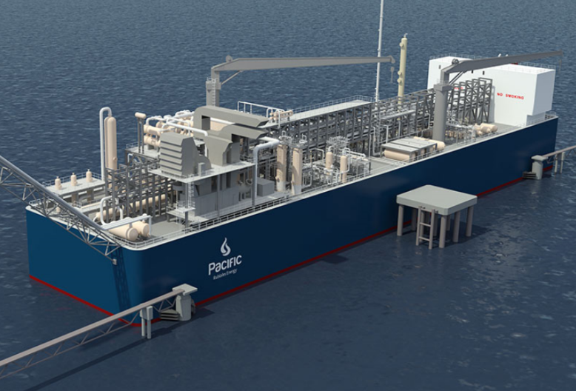
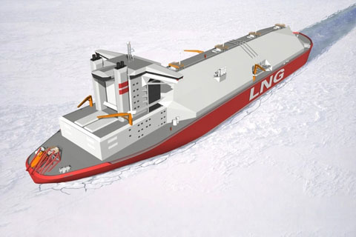
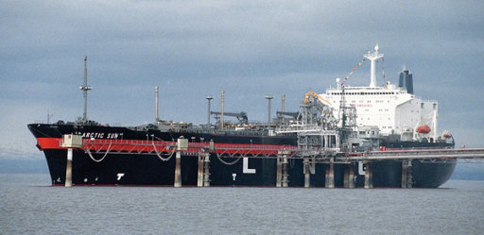
LNG Icebreakers and Floating Plant
New Finnish State Icebreaker – LNG Powered
Barge Mounted LNG Liquefaction Plant
Concept Design – Icebreaking LNG Ships - Yamal
Ice class LNG ship Kenai Alaska

Slide 36
Other “visionary projects”
Ship as the Experiment
Iceworthy ship would be developed to be the engineering experiments itself
Ice transit experiments, hull and propeller loads, study of towing of arrays in ice, ice management strategy development, experiments to develop support of sub-sea developments in ice
Arctic Railway to the Mackenzie Delta
Export oil terminals (e.g. at Churchill or on the Beaufort Sea coast) (as in the recent Canatec study)
“I must go down to the seas again to the lonely sea and sky – and all I ask is a tall ship and a star to guide her by “– John Masefield

Slide 37
Recommendations
Create visionary projects to enable development in Canada’s northern seas.
Possibly integrate some of the proposed ideas, e.g. develop Arctic LNG and use it to power Arctic Railway and Mobile Arctic Engineering Research Platform.
Develop Arctic Engineering Field Research by extending Cambridge Bay CHARS to include the proposed IAEES
Develop the “people” aspects of Arctic Engineering through University-Government-Industry partnerships to maintain Canada’s global leadership in Engineering for Northern Seas.
In all of the above create opportunities for Northern residents.

Slide 38
Themes in the Northern Oceans study which relate to public policy
Development of codes and standards which are then used to create a regulatory framework for infrastructure and vessels
Advances in engineering which enable operations in harsh environments – setting the scene for government policies relating to resource developments.
Studies of the ice conditions for setting engineering design criteria – which also help understand the effects of climate change – which in turn affect climate change responses within public policy.
Similarly understanding how climate change can affect future operations in the Northern Oceans can affect public policy relating to these potential future operations (e.g. longer open water periods).
Adoption of public policies which encourage R&D aimed at improving engineering for Northern Oceans.
Involvement of Northerners in future Northern developments (including the issue of training and education in Northern Engineering topics).
Establishing sovereignty by demonstrating engineering and operational capability.

Slide 39
In Closing
The report is in final draft stage
It will be subject to internal review by CAE
Publication is planned by the Summer

