Slide 1
Reducing GHG Emissions in Canada: A Formidable Challenge
TEFP - Trottier Energy Futures Project
ESMIA Consultants
Annual Meeting of the CAE
Winnipeg, June 27th 2016
TEFP – Milestone Meeting No4
Ottawa, September 30th 2014
www.esmia.ca
www.esmia.ca

Slide 2
Background

Slide 3
Background
Funded by the Trottier Family Foundation (TFF)
Sponsored by the Canadian Academy of Engineering (CAE) and the David Suzuki Foundation (DSF).
Directed by a 3-member Project Board
Quality assurance provided by an Expert Review Panel with dozens of experts from numerous organisations

Slide 4
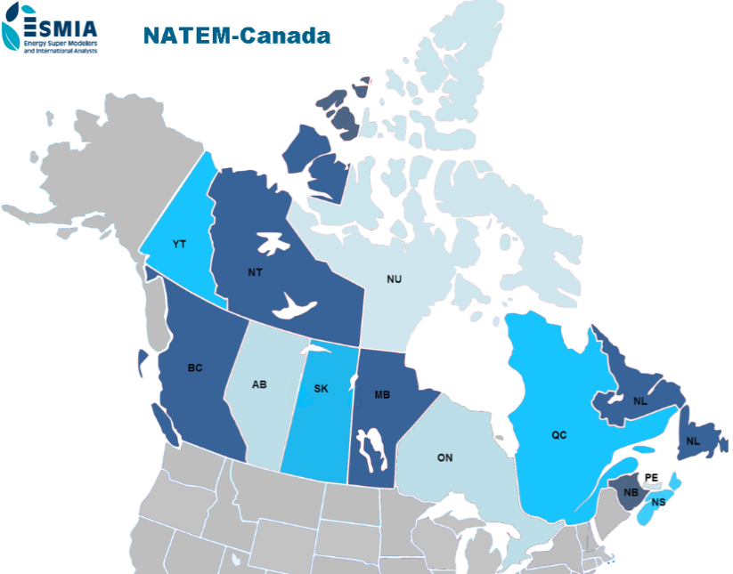
Project goals
To assess options and pathways for reducing GHG emissions in Canada by:
80% by 2050, relative to 1990
more than 100% by 2100

Slide 5
Approach and premises
Broad based team of specialists covering the full range of disciplines:
energy systems analysis, environmental science, economics, electricity supply, fossil fuels, biomass and bio-fuels, transportation, industrial systems, residential/ commercial energy systems, urban systems, agriculture and forestry, carbon capture and retention.
GHG reduction options documented in 14 Working Papers
Cost information coming from hundreds of data sources
Two mathematical models
NATEM-Canada optimization model to find minimum cost solution
CanESS simulation model to provide key inputs and credibility check of results
Discussions and reviews with selected representatives from Government, Industry, Not for Profit organizations, and Universities.

Slide 6
Model description

Slide 7
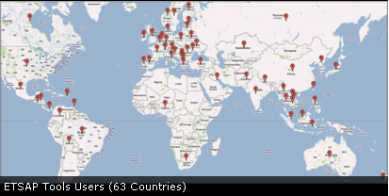
MARKAL/TIMES family of models
TIMES - The Integrated MARKAL-EFOM System
ETSAP of the International Energy Agency
Dynamic linear programming
Detailed and integrated energy systems
Demands for energy services
Medium and long terms
Technology-rich
Partial equilibrium
→ minimise the total discounted cost

Slide 8
MARKAL/TIMES family of models
Technology database
Economic attributes
Technical attributes
GHG coefficients
Energy – Climate Policies
GHG caps
Taxes, subsidies
Sectors’ measures
TIMES
Economic – Energy Inputs
End-use demands for energy services
Demand price-elasticities
Price of imported/exported commodities
Reserve supply curves
Discount rate
Equilibrium
Technology investments and annual activities
Emission trajectories
Adjusted demands for energy services
Marginal prices of energy forms
Imports/exports of energy and emission permits
Total discounted system cost

Slide 9
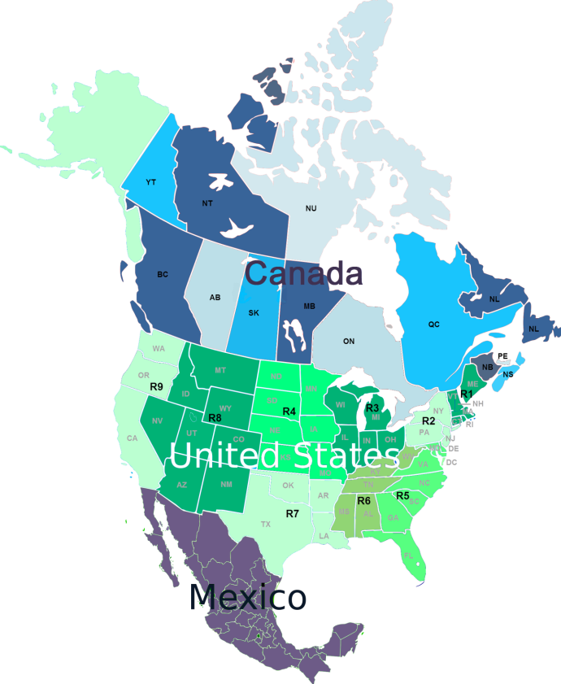
NATEM – a 23-regions model
NATEM – North American TIMES Energy Model

Slide 10
NATEM - Canada
Code | Province/Territory | Region
AB | Alberta | West
BC | British Colombia | West
MB | Manitoba | West
NB | New Brunswick | East
NL | Newfoundland | East
NS | Nova Scotia | East
NT | Northwest territories | North
NU | Nunavut | North
ON | Ontario | Central
PE | Prince Edward Island | East
QC | Quebec | Central
SK | Saskatchewan | West
YT | Yukon | North
Period | 1 | 2 | 3 | 4 | 5 | 6 | 7 | 8 | 9
Start | 2011 | 2012 | 2015 | 2016 | 2025 | 2027 | 2034 | 2037 | 2044
Mid | 2011 | 2013 | 2015 | 2020 | 2025 | 2030 | 2035 | 2040 | 2050
End | 2011 | 2014 | 2015 | 2024 | 2026 | 2033 | 2036 | 2043 | 2056

Slide 11
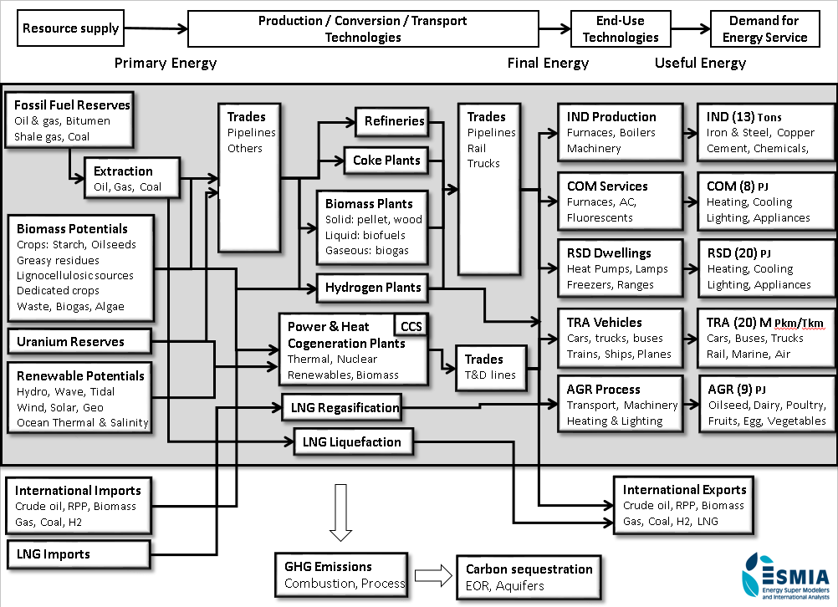

Slide 12
CanESS

Slide 13
Model development

Slide 14
Data bridge

Slide 15
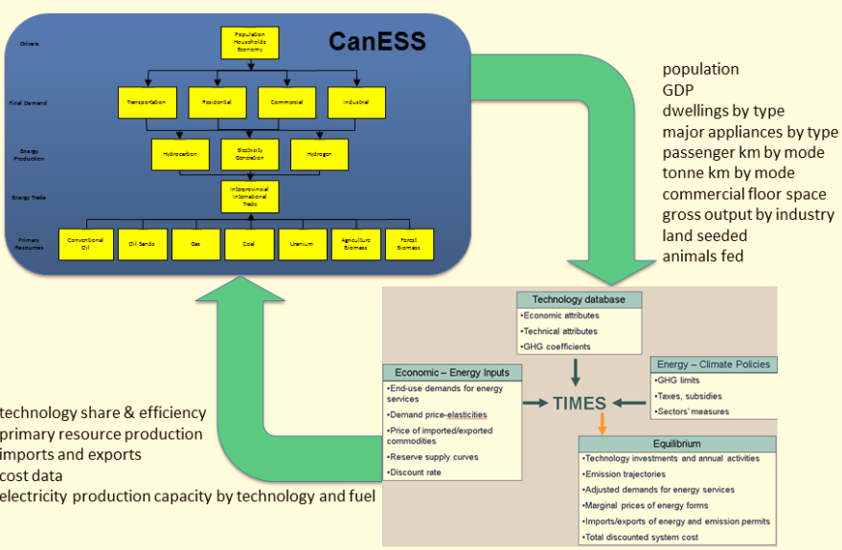
Data bridge

Slide 16
Special considerations
Socio-economic settings
Energy efficiency and conservation
Dependable capacity
System dispatch
High voltage interconnections
Differential costs for grid supply
Biomass feedstock limits
Cost variations over time

Slide 17
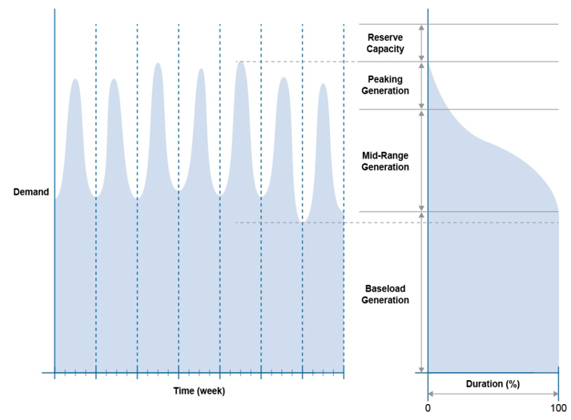
Optimal system dispatch

Slide 18
Model calibration

Slide 19
Socio-economic settings
Notes:
Population projections (Figure 9) were based on application of CanESS’s population model which had been calibrated with Canadian socio-economic information management (CANSIM) system data from 1978 to 2010. The model, using age, gender and region level information, captured continuing population evolution year by year, by applying birth rates, mortality, interprovincial migration, and international migration. It is calibrated to track on CANSIM data from 1978 to 2010 and to track on the National Energy Board’s population by province as published by the National Energy Board (NEB 2013) outlook from 2011 to 2035, by adjusting immigration, emigration and interprovincial migration. Post 2035, international immigration and emigration implied in National Energy Board Data for the period out to 2035 is projected to continue growing in a similar way to 2050. Average population growth rate in historic time (1978-2010) is 1.11%; for the National Energy Board projection period (2010-2035), it is 0.98%; and for the further projection (2035-2050), it is 0.63%.
Provincial GDP values were obtained from CANSIM for 1978 to 2010, and from National Energy Board projections for the 2011-2035 time period. These were then used to calculate GDP per capita values. Growth rate of GDP per capita was projected for the 2036-2050 period using trends from the 2011 to 2035 period, and with small progressive saturation applied to GDP per capita beyond 2035. Inflation is factored out of the calculation by equating to equivalent 2011 dollars (Figure 10). GDP per capita growth rate is slowly declining over the full time series. The average GDP per capita growth rate in historic time (1978-2010) is 1.9%; in the National Energy Board projection period (2010-2035), it is 1.86%; and for the projected period beyond 2035, (2036-2060), it is 1.31 %.

Slide 20
Industrial gross output
Notes:
Total GDP in any year is the product of population and GDP per capita. Projected GDP is shown in Figure 11. Again, this is in equivalent 2011 dollars.
As may be observed, total GDP is projected to more than double between 2010 and 2050.
Information of gross output was obtained from Statistics Canada. Statistics Canada reports gross output in annual (i.e. current) dollars. The CanESS model was used to convert all numbers using GDP deflators by industry into equivalent 2002 dollars (deduced from StatsCan data), with projections based on 2002 dollars. As all work with the NATEM model was based on equivalent 2011 dollars, the CanESS projections were then converted into equivalent 2011 dollars.
The industrial sectors covered with this approach include a subset of total gross output reported in CANSIM 381-0031. It does not include oil, gas & coal production; it also does not include refined petroleum products such as diesel, gasoline, fuel oil etc. It does include petrochemical products as a sub component of chemicals.
Provincial gross output values for non-fuel producing industrial sectors (totalled over industry) from CANSIM for 1978-2010 and from the National Energy Board for 2011-2035 (NEB, 2013) were used to calculate gross output To GDP ratios. These were then projected to the end of simulation time 2036-2050, with saturating projections. Also, the share of industrial gross output for the respective jurisdictions were calculated using the same information from the same sources, and projected, again with a saturating trend. Finally the national gross output by province and industry was calculated by applying the ratio to the GDP and applying the share to the total gross output by province.
Results from these analyses for all of Canada for the non-fuel producing industries for all of Canada are shown on Figure 12.
It was interesting to note that national gross output to GDP ratios have been declining, especially during the recent recession. Although there is some recovery, this does not reach the ratios of the early 2000’s. This reflects the general transition to a service based economy, with some recovery of the industrial sector over time. The provinces with the highest gross output to GDP ratio are Quebec and Ontario and are both still growing. Alberta is quite flat; however the gross output described here does not include fossil fuel industries.

Slide 21
End-use demands (70)

Slide 22
Final energy consumption

Slide 23
Primary energy production

Slide 24
Primary energy production - Gas

Slide 25
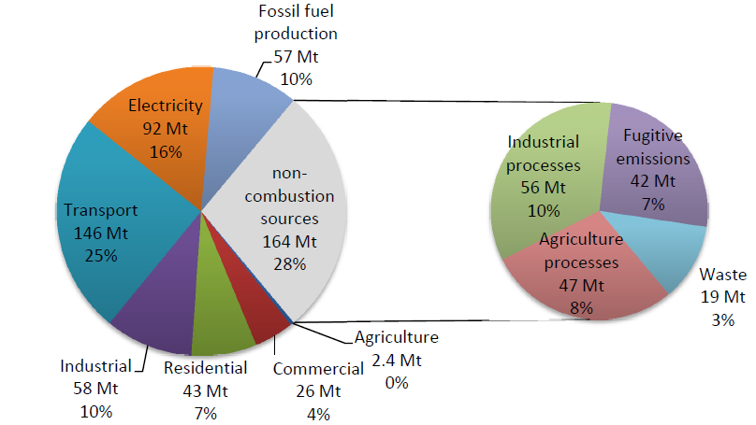
GHG emissions in Canada - 1990
Total: 589 Mt CO₂-eq

Slide 26
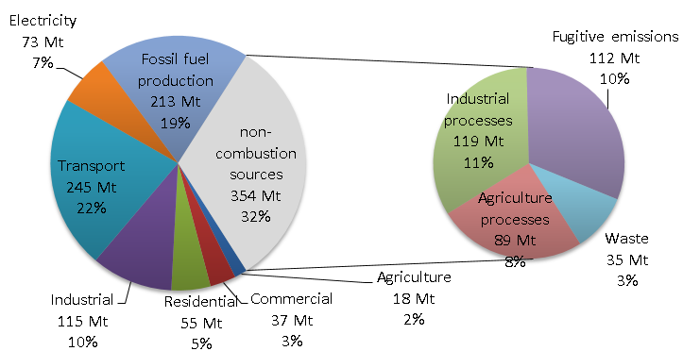
GHG emissions in Canada - 2050
Total: 1109 Mt CO₂-eq
Notes:
Key observations from detailed review of background documentation and results are as follows:
GHG production is dominantly from the transportation, industrial (both combusiotn and industrial process emissions) and fossil fuels supply (combustion and and fugitive emissions).
The most rapid increase in production of GHG’s is directly associated with an expanding oil and natural gas sector, dominantly for increasing export. This also has a corresponding projected increase in production of fugitive releases, which is assumed to be proportional to oil and natural gas production
The observed decrease in emissions from the electricity sector is mainly due to planned phase out of conventional coal generating facilities, elimination of light fuel oil and heavy fuel oil electricity generation, and a significant increase in hydro energy generation. Thermal generation in 2050 is primarily natural gas based generation, dominantly for peaking and mid-range operation in selected jurisdictions.
The declining proportion of GHG emissions from the residential and commercial sectors is due to a combination of improving thermal efficiencies of new buildings and a progressive shift towards electrification of end uses, including especially for space heating.
Changes in GHG emissions intensity for electricity generation are shown in Figure 55. CO₂-eq emissions are shown to decline from 0.13 kg per kWh in 2013, to 0.09 kg per kWh in 2050.

Slide 27
Result analysis

Slide 28
GHG combustion emission targets
755 Mt
299 Mt
171 Mt
70% = 128 Mt
80% = 85 Mt
Notes:
-biggest leap is from REF to -30%
-focusing on R30 and R60 for the presentation
-Only combustion related emissions
The purpose of this scenario was to derive minimum cost solutions to 2050, for all of Canada, for progressive reductions in combustion emissions from 2011 to 2050. The premises were essentially the same as for Scenario 1, but with imposition also of combustion reduction requirements by 2050, which were below the 427 Mt of recorded combustion emission in 1990. Results were derived with the NATEM-Canada model for four separate reduction targets in 2050, from 30 to 60%, in 10% increments.
It is important to note that the 60% reduction target was selected, after several trials, as the maximum realizable target for the combination of possible transformation options prescribed for this Scenario. Any substantive increase in the target beyond 60% did not produce credible results, because of unacceptably high marginal costs.

Slide 29
S8: Energy consumption in transportation

Slide 30
S2: Market shares for space heating
Notes:
Key observations from detailed review of background documentation and results are as follows:
As observed in Figure 59, and again in Figure 60, there is an overall reduction in final energy consumption.
The dominant changes are reduced use of fossil fuels, primarily oil and natural gas, and increased use of electricity and bio-fuels. These trends are progressive, from the 30% GHG reduction target, to the 60% GHG reduction target.
Electrification increases with increasing GHG reduction targets. For the 60% GHG reduction target, electricity meets 53% of energy end use in 2050, as compared to 23% for Scenario 1.
The other significant supply change is with biofuels. For the 60% GHG reduction scenario in 2050, biofuels meet 8% of total energy consumption, which is a 45%% increase, relative to Scenario 1. It should be recognized that this could be in conflict with food production, as both first generation ethanol and biodiesel production are from conventional food production sources.
There are corresponding reductions in use of fossil fuels, with oil use declining by 76% and natural gas by 82%, for the same 60% GHG reduction target in 2050.

Slide 31
A huge challenge
While immediate priorities are clear…
… longer term path requires more research:
Options for heavy freight and rail transportation
Feedstock challenges for production of biomass/ biofuels
Commercial production of 2nd and 3rd generation biofuels
Options for the fossil fuel industry
Mitigation strategies for agriculture and forestry sectors
Industrial emissions (combustion and non-combustion)
Fugitive emissions
Sustainable institutional capacity for research

Slide 32
For more information
Full Technical Report
Executive summary
Project summary
https://www.cae-acg.ca/projects/trottier-energy-futures-project/

Slide 33
Thank you for your attention
Kathleen Vaillancourt
kathleen@esmia.ca
Annual Meeting of the CAE
Winnipeg, June 27th 2016
www.esmia.ca

